Slide 1
CSA National Safety Interventions Rollout
Update on Carrier Investigations
January 2019

Slide 2
When it comes to saving lives…
…we’re all in!
Notes:
Five million truck and bus drivers share the road with more than 250 million motorists.
With stakes so high, it’s essential we continually improve safety compliance to help carriers strengthen their safety records to help make America’s roads as safe as they can be for everyone.

Slide 3
You carry safety to the road
Every day, you and your teams carry safety to the roads, moving people and goods across America.
With 500,000 motor carriers and 750,000 large truck and bus drivers, lives depend on safety on the Nation’s roads.
Your input helped launch FMCSA’s Compliance, Safety, Accountability (CSA) program in 2010—and together, we’re making a positive impact on safety.
An estimated 11,850 crashes were avoided in the first year since launch—triple the results over the previous year.
Carriers receiving warning letters as a first intervention had significant net crash rate reductions—an estimated 24% increase in lives saved.
Roadside violation rates have decreased by nearly 30%.
Learn how SMS results compare to crashes. https://ai.fmcsa.dot.gov/SMS/Home/SMSToCrash.aspx
Notes:
CSA is FMCSA’s safety and compliance program launched in 2010—it launched in 2010 and is making an impact on safety.
Together with our enforcement partners in the 50 States, and with input from industry, we continually test and innovate ways to improve CSA to increase safety for everyone on the Nation’s roads.
You carry safety to the road. We listen to industry to help identify new policies, programs, and technologies to help motor carriers achieve new levels of safety.
*Source: SMS Effectiveness Test (January 2014)

Slide 4
But we can, and must, do more to improve safety
More than 4,000 people die each year in crashes involving large trucks and buses – that’s why the work of continually improving safety never stops.
We’ve added new tools and invested in training so the nation’s enforcement team can consistently reach at-risk carriers faster to prevent compliance problems from becoming critical safety issues.
New tools for motor carriers allow you to easily share your compliance record—often without interruption to your business.
Notes:
FMCSA is investing in training for the Nation’s enforcement team in new tools, policies, and processes to prevent compliance problems from becoming critical safety issues.
Let’s take a closer look at what’s new this year with the CSA National Safety Interventions Rollout…

Slide 5
New tools add efficiency, increase collaboration
Five changes may impact you in 2019:
Carrier Dashboard – A new dashboard in the carrier Safety Measurement System (SMS) will enable enforcement and carriers to work together to resolve safety compliance problems quickly and effectively.
Online Document Management Tool – SMS now offers an efficient way for carriers to upload required documents.
Risk Assessment – All investigations now begin with a data intake process that includes data collection and review.
Offsite Investigations – A simplified policy and process make it possible to complete some Offsite Investigations entirely remotely, without interruption to business.
Motor Carrier Safety Planner – Our new online manual makes it easier to understand and comply with safety regulation—you can even customize and share the Planner with your team.
.
Notes:
The CSA National Safety Interventions Rollout includes new tools to increase investigation efficiencies, based on feedback and testing.
A new Carrier Dashboard in the Safety Measurement System (SMS) offers new online document management tools that will enable carriers to upload required documents for time- and cost-saving process alternatives, such as our new Offsite Investigations, which were tested and proven effective in 10 States before deploying Nationwide.
We’re rolling out a new way to initiate investigations that gives Safety Investigators a jumpstart on carrier documentation review.
And based on user feedback, we’ve updated and redesigned the Education & Technical Assistance (ETA) package—it’s now called the Motor Carrier Safety Planner, and it’s easily accessible online.

Slide 6
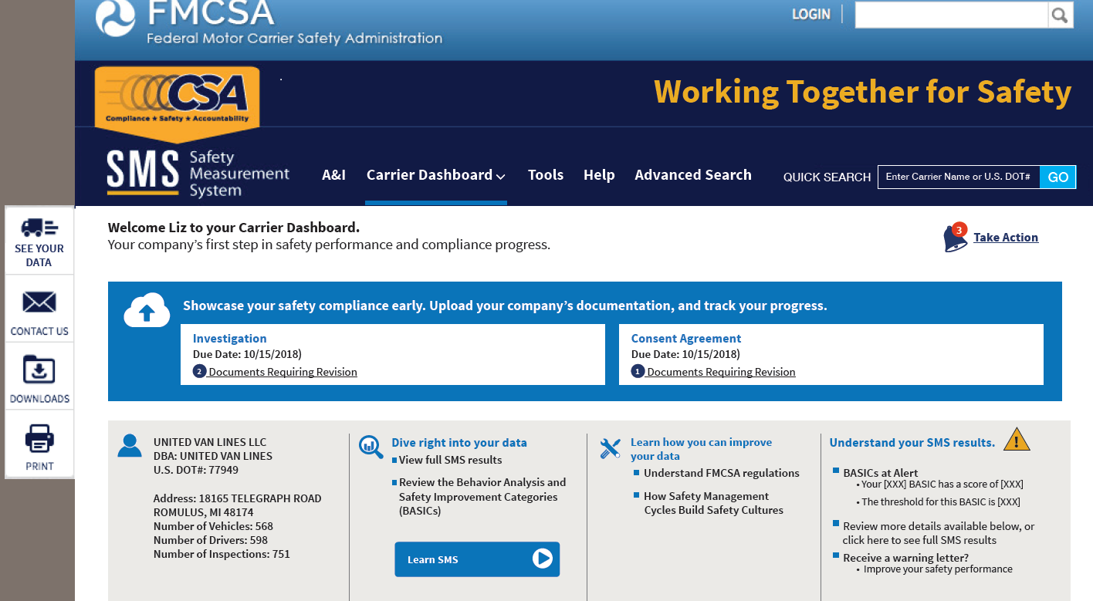
Showcase safety compliance early
Track investigation progress in the blue box.
Check due dates and required documents.
View call-to-action reminders.
Upload documentation to add efficiency.
Learn to use data to increase safety performance.
New Carrier Dashboard
Notes:
Let’s first take a look at the new carrier dashboard.
When carriers log into SMS, instead of being sent directly to their SMS results, they will see this new dashboard. This new feature enables back-and-forth interaction with FMCSA for an efficient way to learn how to improve and understand results. Or, they can dive right into their SMS data.
Carriers undergoing an investigation will see a slightly different dashboard, with a bright blue box like the one in this image. In this box they will see the investigation in process, and will find instructions on how to upload required documents. They will be able to check the dashboard to track the progress of the investigation, see what’s next, and check on deadlines for submissions and other actions.

Slide 7
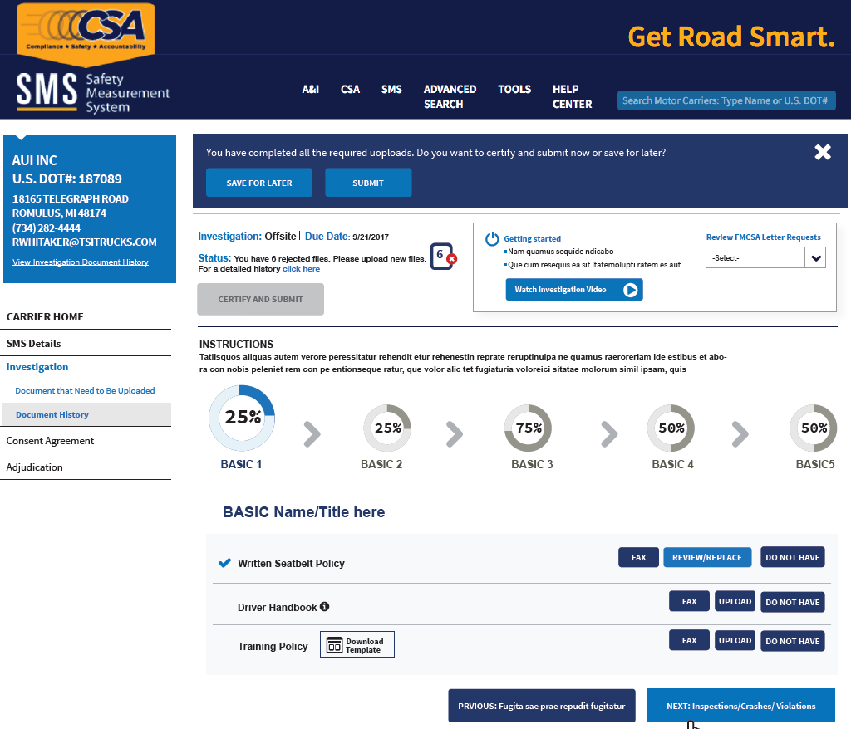
An easy, secure way to deliver compliance documents
Know where you are in the investigative process.
Find standardized forms and templates.
View how-to videos and instructions to learn to use system features.
Online Document Management Tool
Notes:
Carriers will see a new interface that allows them to see exactly what needs to be submitted and when, providing more insight into the investigation process early on. Carriers can get to this page from the dashboard we looked at on the last slide, and when here, can easily upload and submit documents when it is most convenient, reducing disruption to business operations.
Standardized forms and templates are available for carriers to use to complete driver and vehicle lists, and to supply other data, helping ensure investigators get the information they need to keep the investigative process moving smoothly.
Safety Investigators will initially give carriers a call to walk them through the process and confirm next steps.
A video and job aid on this page give carriers instructions on how to upload documents.
The system enables carriers to interact with FMCSA online so they can confirm requests, monitor your progress, and get back to work or on the road.

Slide 8
Every investigation starts with a data intake process
All CSA investigations now begin with a Risk Assessment—a simple intake process to collect documentation and data electronically.
Here’s how the process works:
Safety Investigators send letters to prioritized carriers requesting documentation.
Carriers upload documents using the new SMS Carrier Dashboard.
Safety Investigators review documents for specific safety compliance problems related to BASICs-above-threshold.
Throughout the investigation, carriers and Safety Investigators review, track, and communicate about investigation process.
At the end of the investigations, carriers and Safety Investigators discuss process breakdowns, remedies, and how to improve safety compliance.
Notes:
With the rollout of FMCSA’s CSA National Safety Interventions package in 2019, every State, territory, and jurisdiction will work under the same enforcement model.
As part of the National Rollout Policy, all investigations start with a document review to determine next steps—motor carriers will submit documents electronically, using their secure SMS account, to allow for an FMCSA review with minimal disruption to carrier operations.
Carriers that have been prioritized for an intervention will first receive a document request letter from a Safety Investigator, who will explain the details and walk the carrier through the investigative process.
The carrier and Safety Investigator will now use the new online system to stay in communication and work together to track the progress of an investigation.

Slide 9
Learn how to improve, comply, then get back to work
Based on the scope of a carrier’s safety performance, investigations can continue as:
Onsite Comprehensive – Conducted at a carrier’s place of business, addresses operation-wide compliance
Onsite Focused – Conducted at a carrier’s place of business, focuses on specific compliance issues
Offsite – Conducted completely remotely, addresses emerging safety problems
States tested Offsite Investigations and found them effective.
Within 12 months of an Offsite Investigation, 60% of carriers improved their safety performance, eliminating the need for a more time-intensive Onsite Investigation.
Within 12 months of an Offsite Investigation, 80% of carriers no longer required investigation in at least one of their BASICs.
Within 24 months of an Offsite Investigation, just 11% of carriers escalated to an Onsite Investigation.
Notes:
Following the review of uploaded documents, Safety Investigators will confirm whether the investigation can continue remotely – or if a visit to a carrier’s place of business is warranted.
Regardless of the investigation type, Safety Investigators follow the same thorough process – but modify the scope of the investigation depending on the specific requirement.
There are many reasons an investigation can advance to an Onsite, including situations in which Offsites are not allowed. Offsite Investigations are not allowed in investigations related to Hazmat Safety Permit for instance, or with motorcoaches, or those which address High-Risk carriers. Offsite Investigations may also be converted to an Onsite if a carrier is unresponsive to requests for information, or doesn’t meet requirements and deadlines.
All investigations benefit from the Safety Management Cycle, a series of steps carriers can use to address safety challenges in their operations.
The closeout process for any investigation includes a carrier report that is now in a user-friendly, easy-to-follow format and makes it easier for carriers to understand and comply with investigation recommendations.

Slide 10
Increased efficiencies, increased safety
Limit company downtime: On-time uploads and carrier responsiveness streamline the investigation process.
Flexible and convenient: Documents can be collected and submitted at any time.
Easy to use: Instructions are simple, and carriers and Safety Investigators can view documents online.
Opportunity for collaboration: Cooperating carriers receive important input to improve compliance.
Efficiency leads to improved safety: For every 100 investigations, 14 crashes are prevented.
Notes:
New tools and processes have been introduced to increase compliance, add efficiency—and improve safety on the Nation’s roads.
These enhancements bring additional benefits that will improve the investigative process for motor carriers:
Document collection and submission is an easier and more flexible process, and can be completed online at any time, reducing company downtime and streamlining investigations.
Carriers and Safety Investigators will be able to communicate online to quickly address safety challenges and document issues to increase efficiency and collaboration.
The new carrier dashboard in SMS is easy to use, with simple to follow instructions and how-to videos.

Slide 11
New online guide helps you strengthen your safety record
FMCSA’s new Motor Carrier Safety Planner makes it easy to understand safety rules and regulations, keeping the Nation’s highways safer for everyone.
Visit the Planner homepage to get started. https://csa.fmcsa.dot.gov/safetyplanner/
Motor Carrier Safety Planner Homepage
Notes:
FMCSA is committed to giving carriers the tools they need for success in safety.
Our new online Motor Carrier Safety Planner has been developed to make it easier for carriers to understand and comply with Federal Motor Carrier Safety Regulations

Slide 12
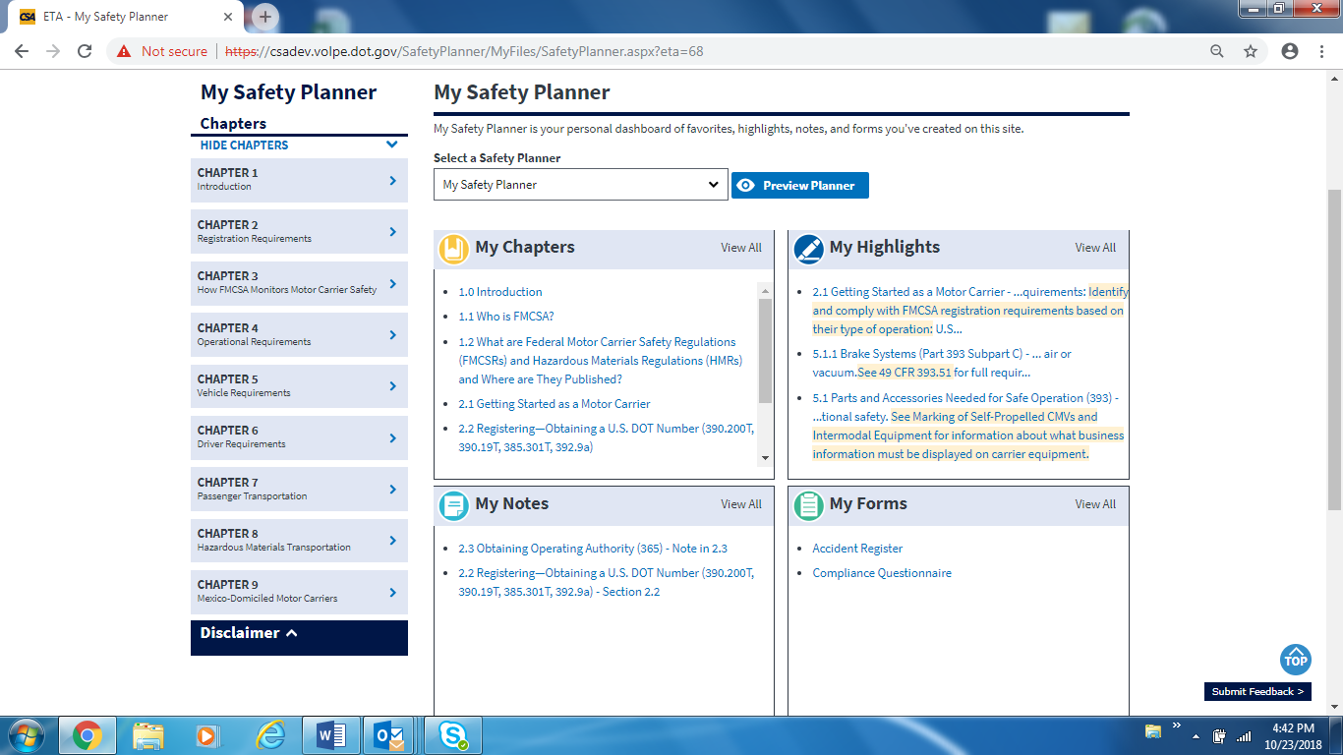
Safety compliance makes good business sense
Raise awareness about safety compliance at your workplace with easy-to-read content in a user-friendly online format.
Use the new Planner to tailor information to your team’s safety compliance information needs.
Customize the Planner to support and meet your company’s safety performance improvement goals.
Motor Carrier Safety Planner Customizable Dashboard
Notes:
With an FMCSA Portal account, carriers can create personalized versions of the Motor Carrier Safety Planner.
They can customize the planner for the workplace and share with their teams, adding and saving bookmarks, highlights, notes, and forms.
They can find, save, and share content related to compliance concerns and ways to improve safety performance.
The new Planner is a flexible tool carriers can use to support company safety performance goals and operational needs.

Slide 13
Make safety Job 1 with these simple steps
Learn more about CSA https://csa.fmcsa.dot.gov/YourRole/MotorCarriers
Visit SMS, and log in to use the SMS Carrier Dashboard
https://ai.fmcsa.dot.gov/SMS
How-to Video
Carrier Upload Instructions
If you do not have or know your U.S. DOT Personal Identification Number (PIN), please visit https://safer.fmcsa.dot.gov/AutoPin/index.xhtml
Bookmark the Motor Carrier Safety Planner https://csa.fmcsa.dot.gov/safetyplanner/
Video Tutorials
Notes:
Learn more about CSA and the steps you can take to help keep the Nation’s highways safer for everyone.
Visit the Motor Carrier Resource Center on the CSA website to find resources you and your team can use to improve safety performance
Log into SMS to explore the new Carrier Dashboard, view the how-to videos, and find instructions on easy document uploads and how to track the progress of an investigation.
Check out the Motor Carrier Safety Planner—video tutorials on the Planner site will help carriers make the most of this new resource.

Slide 14
Contact FMCSA with questions about CSA http://csa.fmcsa.dot.gov/CSA_Feedback.aspx 877-254-5365 Call your local Division Office https://www.fmcsa.dot.gov/mission/field-offices
Q
A
Working together for safety.
Notes:
We encourage you to take full advantage of these new resources,and to share your comments, feedback, and questions.
Because when it comes to safety, we’re all in.
Thank you.

